Slide 1

Problems on Mean and Variance 2007

Slide 2
Reference
Data
Youtube
Code

Slide 3
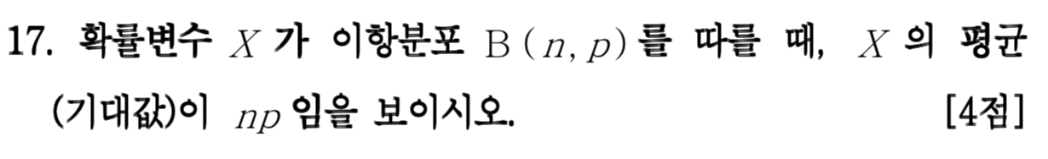
[2007]

Slide 4
Direct Computation

Slide 5
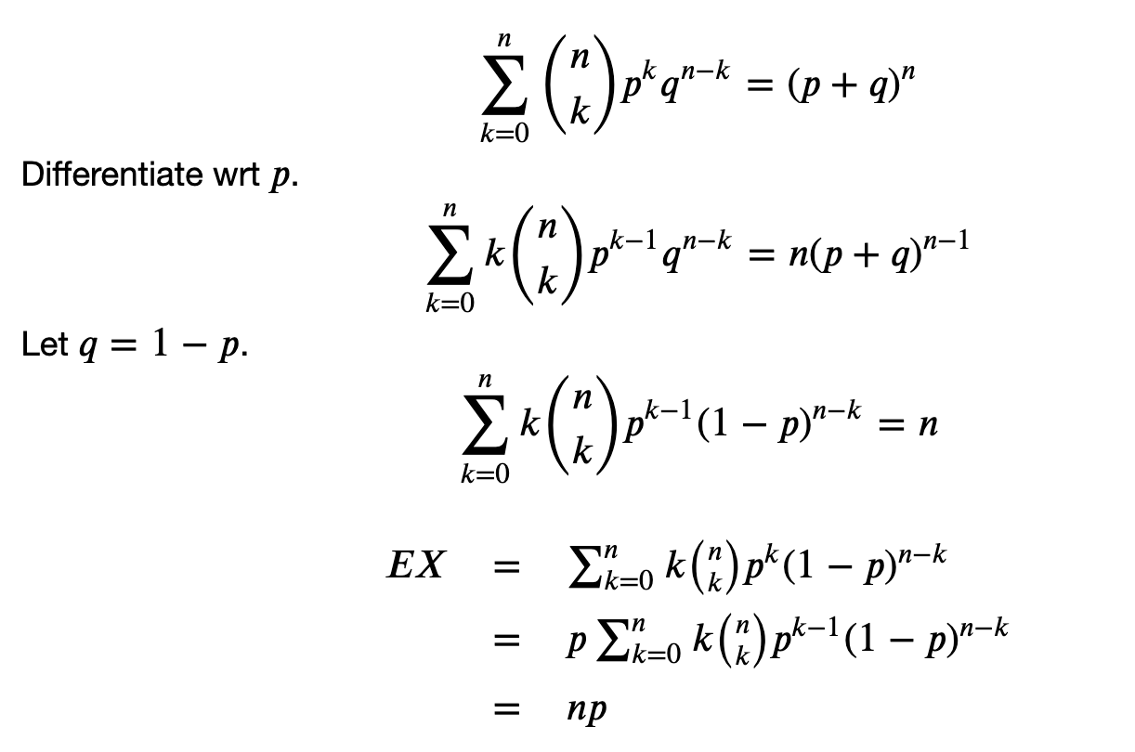


Slide 13
Decomposition

Slide 14
